Slide 1
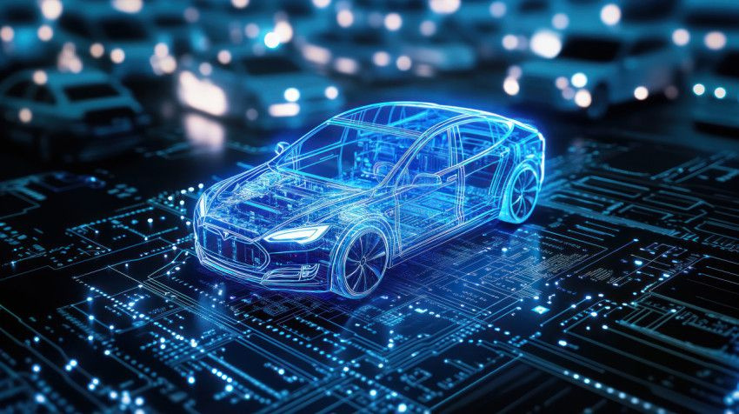

Vision-Based Obstacle Detection and Avoidance System for an Autonomous Car

Slide 2

UNDER SUPERVISION OF :
Dr/ Manal Tantawi
TA/Aya Nasser
TEAM MEMBERS :
Esraa Bassiouny Mohammed
Sara Eslam Mohammed
Ziad Yasser Moussa
Ziad Khaled Ibrahim
Amr Mohammed Ibrahim

Slide 3
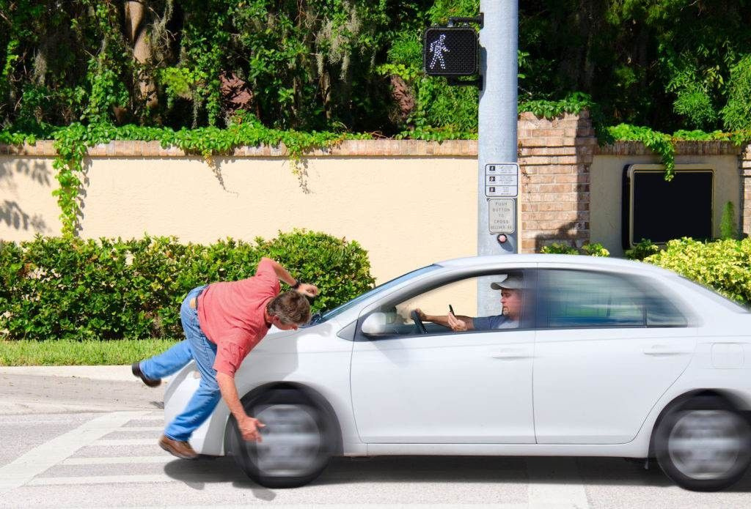
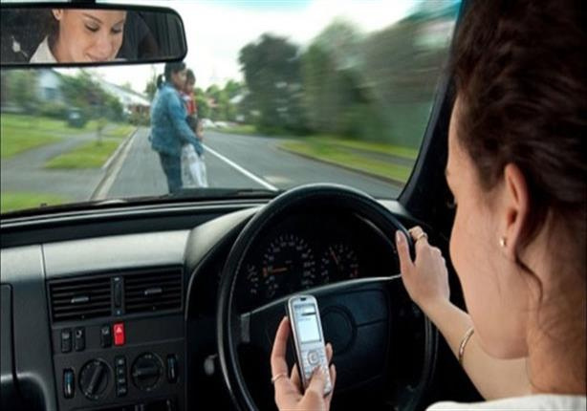
PROBLEM DEFINITION
Conventional vehicles depend on human perception and reaction, leading to accidents caused by distraction or delayed response. Existing autonomous systems are often too complex and expensive for wide use. The key challenge is creating an affordable vision-based system that can accurately detect obstacles, recognize traffic signs, and make real-time decisions for safe navigation.

Slide 4
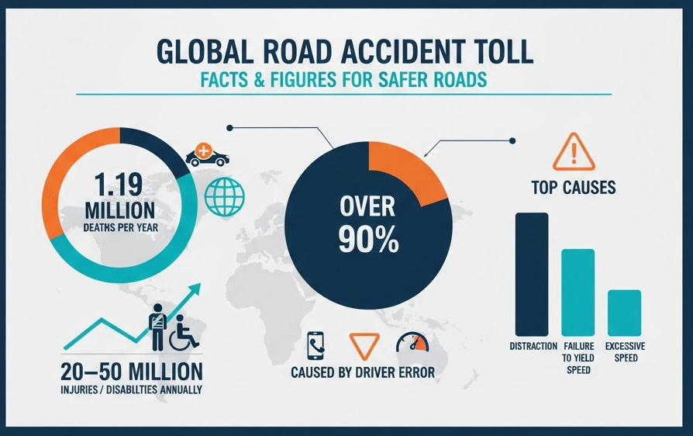
MOTIVATION
Road accidents cause ~1.19 million deaths and 20–50 million injuries annually worldwide.
Over 90% of accidents are caused by human error, mainly due to distraction, ignoring traffic rules, and excessive speed.
Human error being the major cause motivates the development of safer autonomous systems.

Slide 5
OBJECTIVES
Develop a self-driving car system capable of detecting and classifying obstacles.
Enable intelligent decision-making based on real-time perception.
Integrate vision-based perception with sensor data for a cost-effective and adaptable solution.
Enhance road safety by reducing dependency on human attention and reaction time.
Key Objectives
Object Detection: Identify vehicles, pedestrians, and traffic signs using camera input and AI models.
Decision-Making & Obstacle Avoidance: Perform safe driving actions such as braking, steering, and speed control based on detected obstacles and road conditions.
Hardware Implementation: Build a prototype car to demonstrate real-world system performance.
Integration: Combine sensors, cameras, and control modules with AI software for smooth autonomous operation.

Slide 6

SURVEY OF CORE AUTONOMOUS DRIVING COMPONENTS
Datasets
Custom & Local: Many research prototypes rely on custom-captured images adapted to their specific, localized environments and traffic signs.
Object Detection
Deep Learning: CNNs , Faster RCNN and lightweight models like YOLO (v5,v8) are widely used for detecting cars and pedestrians.
Computer Vision: Classical methods like Hough Circle Transform and Edge Detection are used in low-cost prototypes for simple tasks, such as detecting circular traffic signs.
Depth Sensing: Object detection is complemented by traditional distance sensors (Ultrasonic) .

Slide 7
MOST COMMON MODELS IN OBJECT DETECTION
Convolutional Neural Networks (CNNs)
Extract hierarchical features: edges → shapes → complete objects
Robust to lighting changes, noise, and partial occlusion
FASTER R-CNN (TWO-STAGE DETECTOR)
Uses a Region Proposal Network (RPN) to suggest object regions
Provides high accuracy, especially in complex environments
Suitable when precision > speed (research and analysis)
YOLO (v5, v8) — One-Stage Detector
Processes the entire image in a single pass
Real-time performance (30–60 FPS)
YOLOv8 enhancements:
Anchor-free detection - Strong feature pyramids -Excellent on small or custom datasets

Slide 8
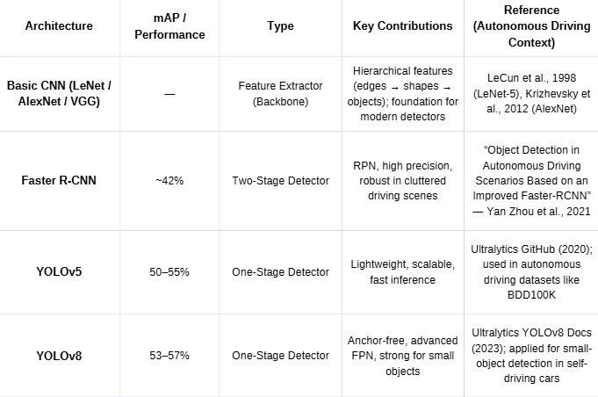
MOST COMMON MODELS IN OBJECT DETECTION

Slide 9
SURVEY OF CORE AUTONOMOUS DRIVING COMPONENTS
How Cars Make Decisions
Rule-Based Systems: Traditionally, many autonomous driving systems rely on rule-based approaches to make driving decisions.
Reinforcement Learning (RL): In advanced autonomous systems, Deep Q-Networks (DQN) are used to learn how to drive safely and efficiently by maximizing rewards for good actions.
Hardware Used
Low-Cost Embedded Systems: Many prototypes utilize accessible, affordable hardware like Raspberry Pi as the processing unit, paired with simple Cameras and Ultrasonic Sensors.

Slide 10
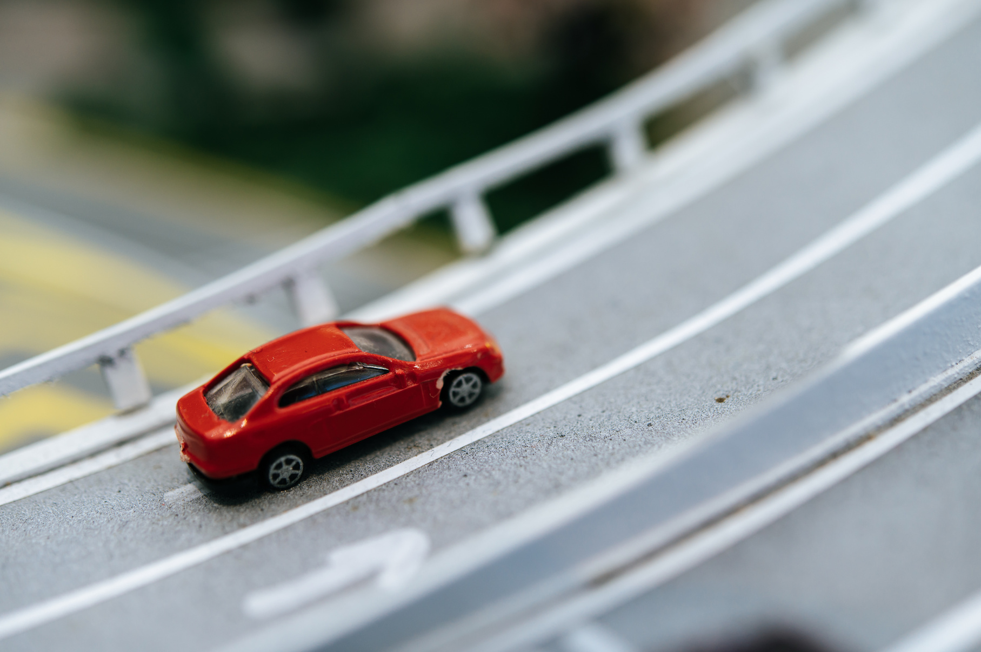
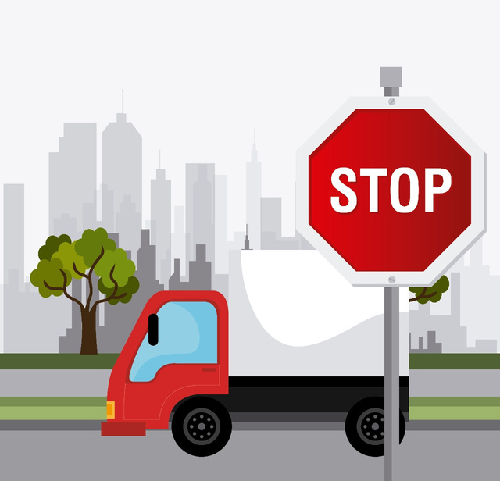
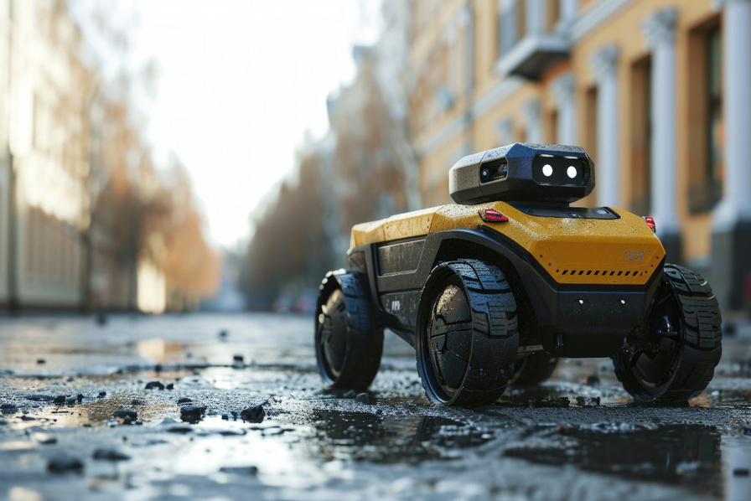
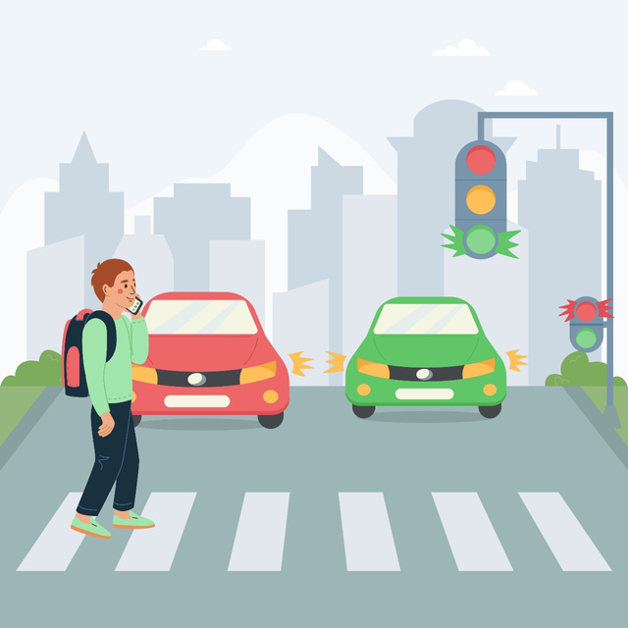
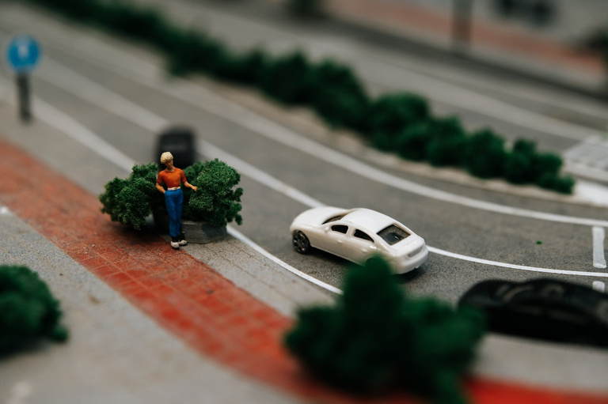
WHAT MAKES OUR PROJECT DIFFERENT
Unlike most existing works that focus on only one aspect or detect specific objects, our project combines object detection, obstacle avoidance, decision-making, and real-time hardware implementation, using camera input and AI models to recognize multiple object types simultaneously for more complete autonomous perception.

Slide 11
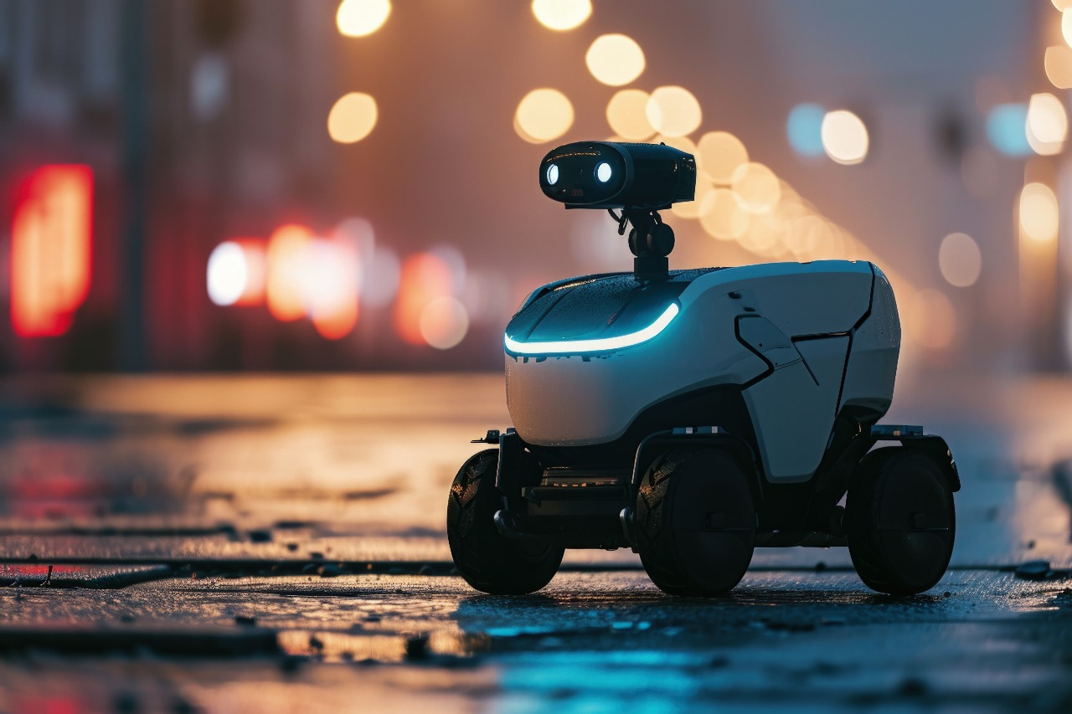
EXPECTED OUTCOME
A self-driving car prototype capable of detecting multiple objects and making safe, real-time driving decisions such as stopping, steering, and speed control to achieve efficient and reliable autonomous navigation.

Slide 12

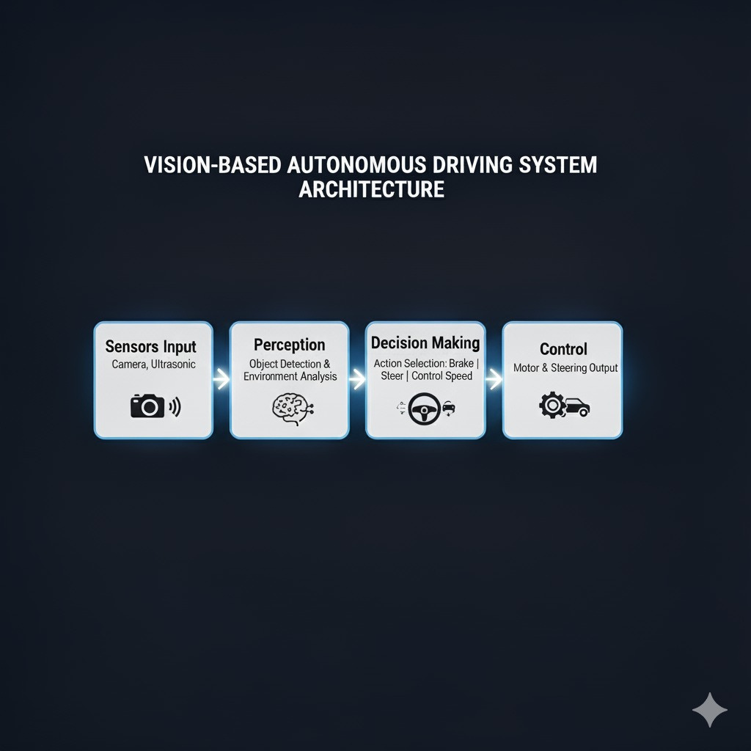

Slide 13
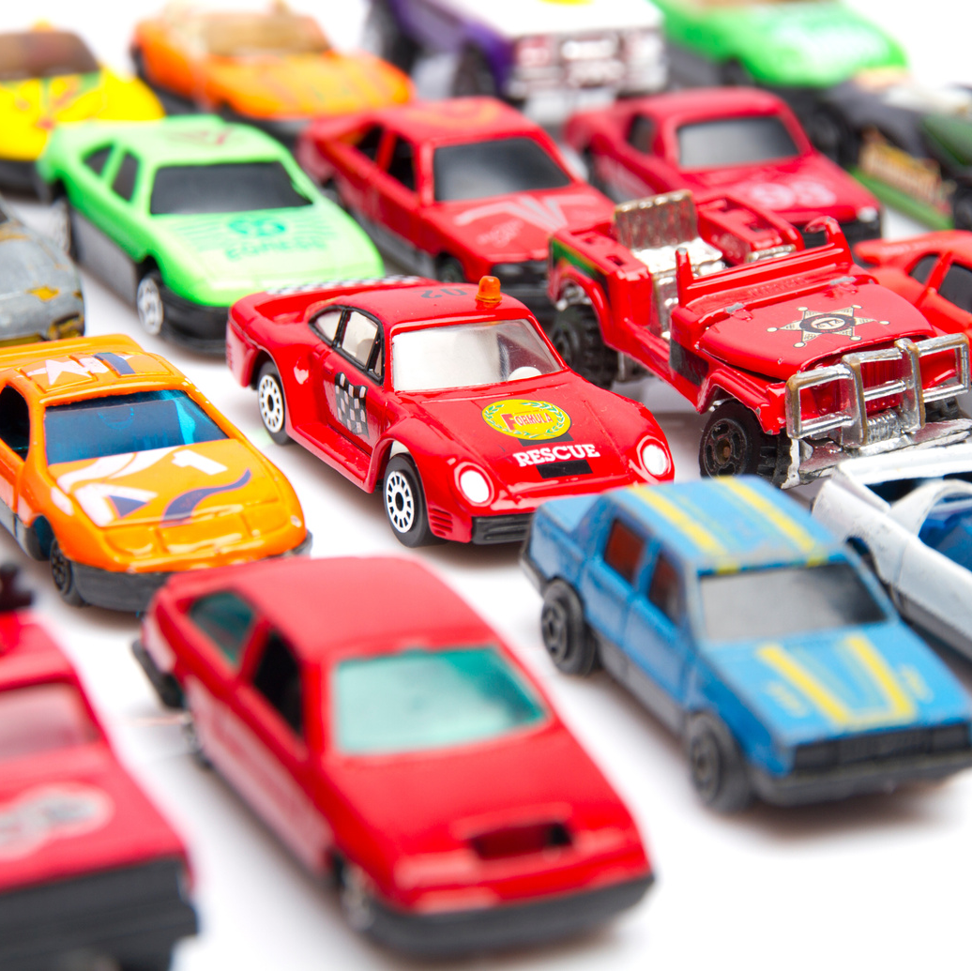


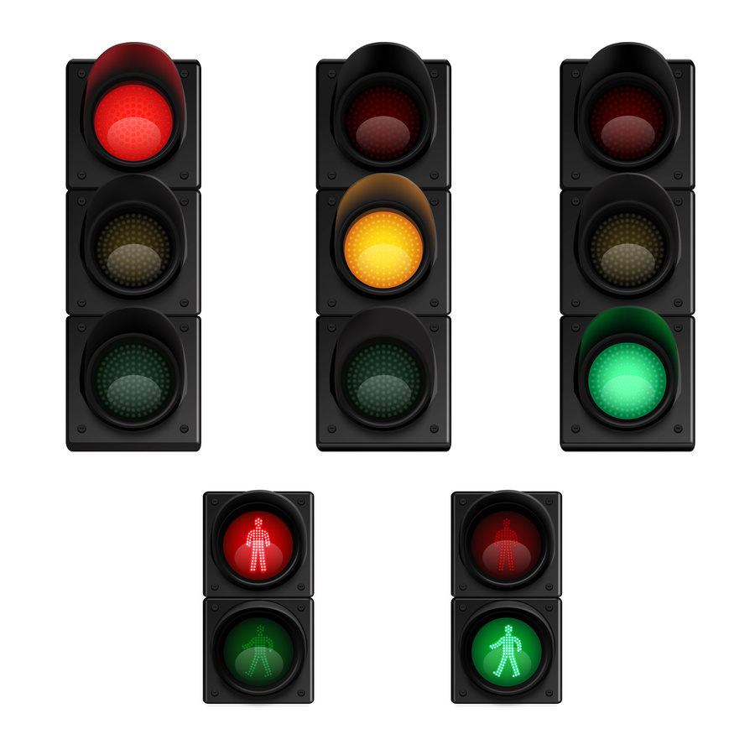
DATASETS
🚗 Toy Cars Dataset – Represents real cars with different orientations, distances, and lighting.
🧍‍♂ Lego Person Dataset – Simulates pedestrians crossing or standing near the road.
🛑 Stop Sign Dataset – Used for traffic sign detection and decision-making.
🚦 Traffic Light Dataset – Includes red, yellow, and green lights to train color-based traffic control recognition.

Slide 14
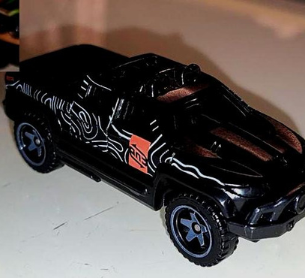
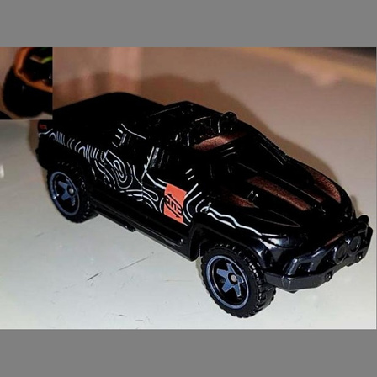
DATA PREPROCESSING AND PREPARATION
Before Resizing (640x480)
1. Image Resizing
All images were resized to 640×640 pixels (maintaining aspect ratio and padding the rest) to ensures consistent input size for the YOLO model while avoiding distortion that could affect object shapes and bounding boxes.
2. Color Format Conversion
Converted all images from BGR to RGB format as YOLO and most deep learning frameworks expect RGB format for accurate color interpretation, especially important for traffic light colors.
3. Data Normalization
Pixel values were scaled to [0, 1] to improve model convergence speed.
After Resizing (640x640)

Slide 15


DATA PREPROCESSING AND PREPARATION
4. Label Verification and Alignment
Verified that all bounding boxes match image coordinates and that class indices are correctly mapped (toy-car=0, lego=1, stop-sign=2, green=3, red=4, yellow=5) to ensure the YOLO model learns the correct object-class associations.
5. Data Augmentation
Applied light augmentations , including: Horizontal flip, Slight saturation changes, Motion blur and Random scaling (±30%) to increases dataset diversity, reduce overfitting, and help the model generalize better to different lighting, orientation, and motion conditions.
Augmentation was applied only to underrepresented classes and prevent bias toward frequent objects like toy cars.
Before Augmentation
After Augmentation

Slide 16
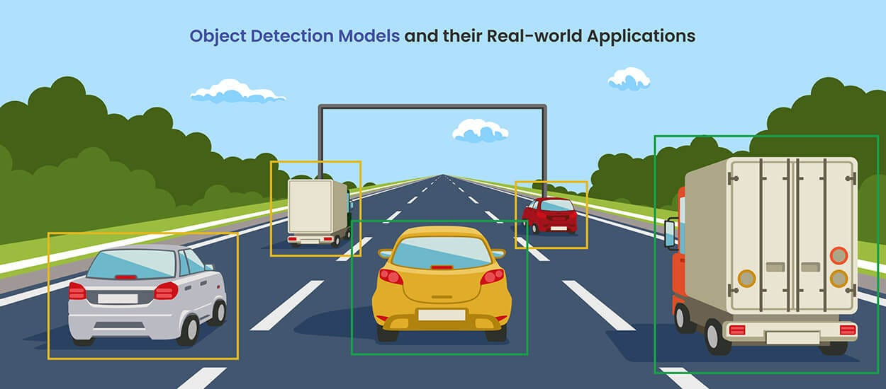
OBJECT DETECTION MODEL (YOLO)
YOLO (You Only Look Once) is ideal for our self-driving car project
1- it provides real-time object detection with high accuracy, small model size, and efficient performance on embedded hardware.
2- Unlike traditional CNN-based detectors such as Faster R-CNN or SSD, YOLO performs detection and classification in a single forward pass, allowing our car to react instantly to obstacles, traffic lights, and stop signs.
3- Its multi-scale architecture enables accurate detection of both large and very small objects, such as distant traffic lights.
4- It is easy to train on our custom dataset and runs smoothly on hardware These advantages make YOLO the most suitable model for safety-critical and resource-limited autonomous vehicle systems.

Slide 17
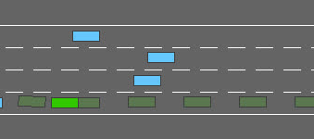
DECISION-MAKING & OBSTACLE AVOIDANCE
Rule-Based Control:
The system initially uses a rule-based approach, where actions are defined by preset conditions .
This allows for straightforward testing and ensures reliability during early development.
Exploring Reinforcement Learning:
We are currently surveying Reinforcement Learning (RL) techniques to enhance obstacle avoidance and decision-making.
RL models learn from experience to balance safety and efficiency, enabling the vehicle to make more adaptive driving decisions in complex environments such as highways or multi-lane roads.
highway-env

Slide 18
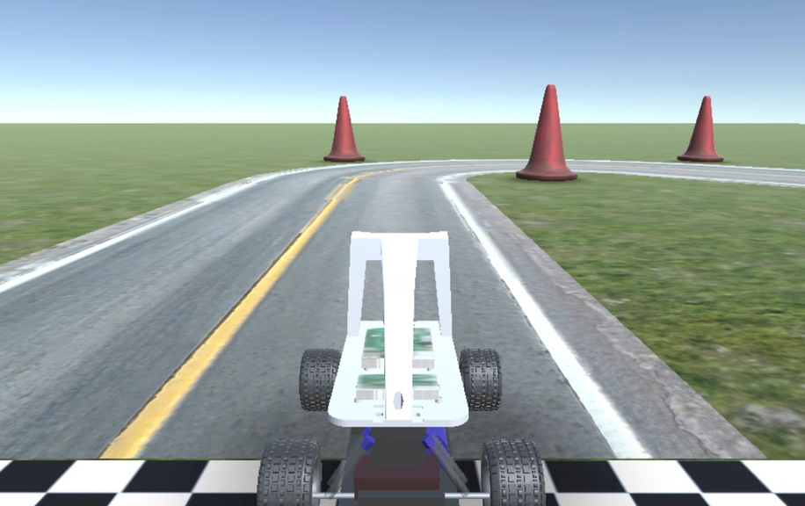
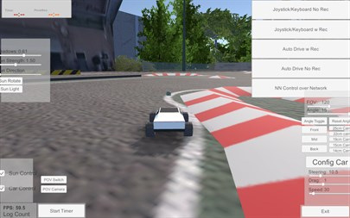
DONKEYCAR SIMULATOR
A Unity-based simulator for small-scale autonomous car experiments.
Uses a front-facing camera view to simulate the car’s perspective.
Supports steering control, path following, and obstacle avoidance tasks.
The model is trained on virtual driving data, enabling easy transfer to a real car with minor adjustments.
Integrates seamlessly with real hardware (e.g., Raspberry Pi and camera), bridging the gap between simulation and real-world testing.

Slide 19
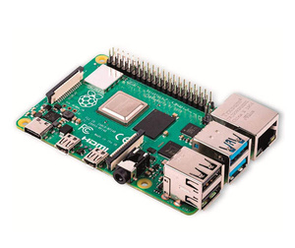
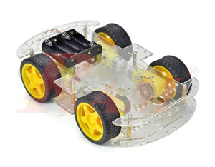
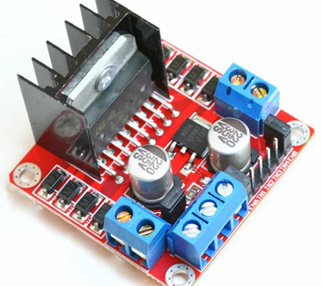
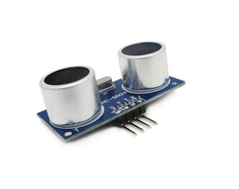
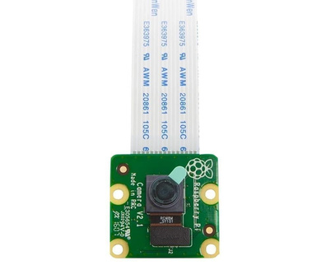
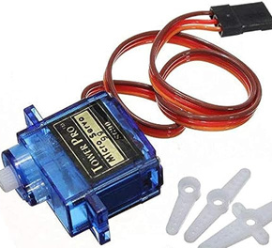
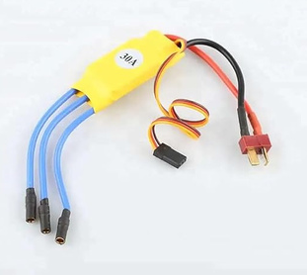
HARDWARE
1- Processing Unit
3- Vehicle Platform
Raspberry Pi 4 :
Main processing board for AI computation and real-time control.
RC Car Chassis 4WD : Four-wheel drive platform for real-world testing of autonomous navigation.
2- Sensors
Motor Driver (L298N) : Controls the motors of the chassis.
Ultrasonic Sensor :
Measure distance to obstacles for collision avoidance.
Electronic Speed Controller (ESC) & Servo :
Manages speed and steering for precise control.
Camera Module : Captures visual input for object detection and environment analysis.
Servo
ESC

Slide 20
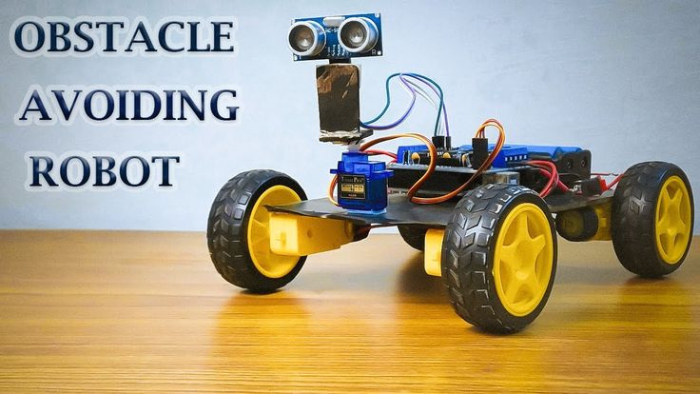
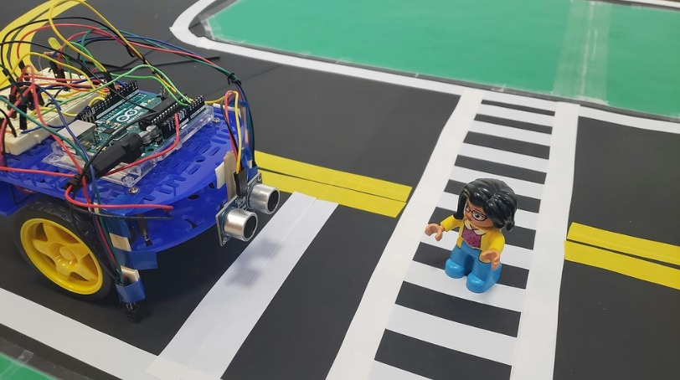
REAL-WORLD TESTING & EVALUATION
We’ll test the prototype in controlled environments, such as:
A small track with lane markings.
Obstacles represented by toy cars or pedestrians (LEGO, boxes, etc.).
Detecting obstacles accurately.
Responding safely (stop, slow down, or steer around).
Maintaining smooth motion and stable control.

Slide 21

GRADUATION PROJECT FUNDING
Our project was submitted for funding and support to the Academy of Scientific Research and Technology (ASRT) under Individual Projects category
A program directed toward final-year students.
Through this funding, we aim to:
Enhance our prototype development using advanced components and computing units.
Support local innovation in the field of intelligent transportation and autonomous systems.
Translate our research into a real, scalable product that can improve road safety and driver assistance technologies.

Slide 22
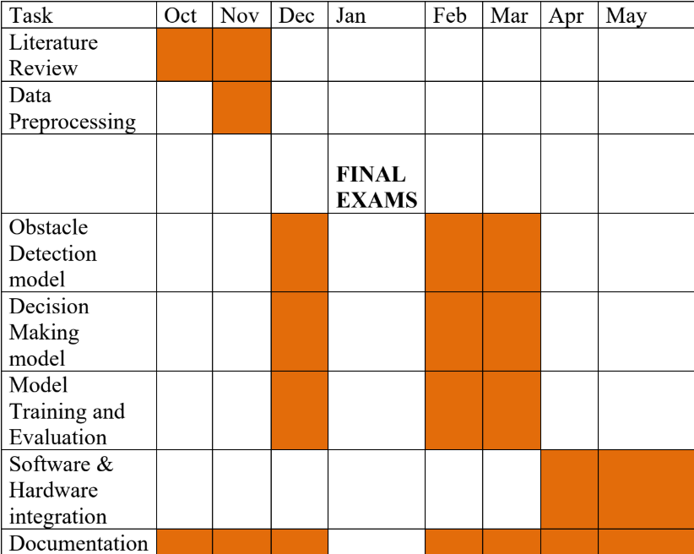
TIME PLAN

Slide 23
TOOLS:
Programming Languages: Python (TensorFlow, PyTorch, OpenCV),C++(ROS integration)
Libraries: NumPy, Matplotlib, Scikit-learn, Pandas
AI Frameworks: TensorFlow, PyTorch, Keras
Simulation Platforms: Highway and Donkycar Simulator
Computer Vision: OpenCV
Data Visualization: Matplotlib, Seaborn
Development Environment: Jupyter Notebooks, PyCharm, or VSCode
Version Control: Git/GitHub
Hardware components: Raspberry Pi 4, Arduino/ESP32, Camera Module, Ultrasonic Sensors, IR Sensors, DC Motors with L298N Driver

Slide 24
RESOURCES
[1] M. Bojarski et al. End-to-End Learning for Self-Driving Cars. arXiv:1604, 2016.
[2] J. Huang, V. Rathod, C. Sun, M. Zhu, A. Korattikara, A. Fathi, I. Fischer, Z. Wojna, Y. Song, S. Guadarrama, et al. Speed/accuracy trade-offs for modern convolutional object detectors. In Computer Vision and Pattern Recognition (CVPR), 2017.
[3] M. Rastegari, V. Ordonez, J. Redmon, and A. Farhadi. XNOR-net: Imagenet classification using binary convolutional neural networks. In European Conference on Computer Vision (ECCV), 2016.
[4] C. Stiller, J. Hipp, C. Rössig, & A. Ewald, “ Multisensor obstacle detection and tracking”, Image and Vision Computing, vol.18 (5), pp.389–396, 2000.
[5] Redmon, J.; Divvala, S.; Girshick, R.; Farhadi, A. You only look once: Unified, real-time object detection. In Proceedings of the IEEE Conference on Computer Vision and Pattern Recognition, Anchorage, AK, USA, 23–28 June 2008; pp. 1–8.
[6] K. Lee and H. Peng, ”Evaluation of automotive forward collision worning and collision avoidance algorithms,” Vehicle System Dynamics,vol. 43(10), pp. 735-751, Feb. 2007.
[7] M. Bojarski, D. D. Testa, D. Dworakowski, B. Firner, B. Flepp, P. Goyal, L. D. Jackel, M. Monfort, U. Muller, J. Zhang, X. Zhang, J. Zhao and K. Zieba, ”End to end learning for self driving cars,” arXiv preprint, arXiv:1604.0731, Apr. 2016.
[8] C. Chen, A. Seff, A. Kornhauser and J. Xiao, ”DeepDriving: learning affordance for direct perception in autonomous driving,” Proceedings of the IEEE International Conference on Computer Vision(ICCV), pp.2722-2730, 2015.

Slide 25
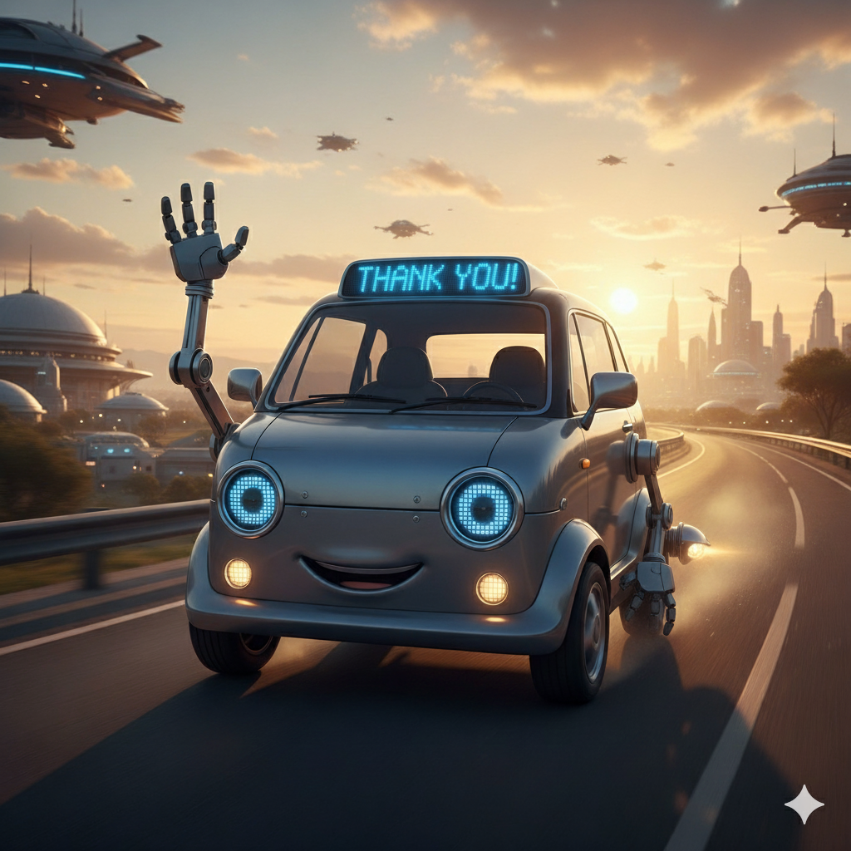
THANK YOU

